Slide 1
Digital Portfolio
STUDENT NAME: T.DIVAKAR
REGISTER NO AND NMID: asbrubz2422K2723
DEPARTMENT: II.B.SC.COMPUTER SCIENCE
COLLEGE: GOVERNMENT ARTS & SCIENCE COLLEGE,BHARATHIYAR.
UNIVERSITY

Slide 2
PROJECT TITLE
STUDENT DIGITAL PORTFOLIO USING
FRONT AND DEVELOPMENT

Slide 3


AGENDA
Problem Statement
Project Overview
End Users
Tools and Technologies
Portfolio design and Layout
Features and Functionality
Results and Screenshots
Conclusion
Github Link
3/21/2024 Annual Review

Slide 4

PROBLEM STATEMENT
In the current digital era, students need a professional platform to showcase their academic achievements, skills, projects, and extracurricular activities. Traditional resumes or paper-based portfolios are limited in accessibility, lack interactivity, and do not reflect technical abilities effectively.There is a need for a digital portfolio system where students can present their personal details, educational background, skills, projects, certifications, and contact information in a visually appealing and interactive manner.

Slide 5

PROJECT OVERVIEW
A Student Digital Portfolio is a personal website that showcases a student’s biodata, academic details, skills, projects, and achievements. It is created using front-end web development technologies such as HTML, CSS, and JavaScript.This project helps students present themselves professionally, practice front-end development skills, and build an online presence useful for jobs, internships, or higher studies.

Slide 6

WHO ARE THE END USERS?
Teachers / Professors – to evaluate the student’s skills, projects, and learning progress.
Recruiters / Employers – to review the student’s qualifications, technical skills, and past projects for internships or jobs.
College / Placement Cell – to showcase the student’s profile for academic or placement purposes.

Slide 7

TOOLS AND TECHNIQUES
HTML Structure of the portfolio (headings, paragraphs, lists, tables, images).Example: Biodata, project details, and education timeline.
CSS Styling the portfolio (colors, fonts, layouts, responsive design).Techniques used: Internal CSS (inside <style> tag)External CSS (separate .css file)Inline CSS (directly in HTML tags)
JavaScript Adding interactivity (form validation, animations, dark mode toggle, etc.).Example: Contact form validation, navigation bar effects.
Front-End Frameworks (Optional)Bootstrap / Tailwind CSS → for responsive layouts.React.js (advanced option) → for dynamic portfolio websites.
Development ToolsCode Editor: CODEPEN and hosting platform (GitHub Pages).

Slide 8
POTFOLIO DESIGN AND LAYOUT
Modern design (rounded cards, shadows, blue highlight).
Sections: About, Skills, Projects, Education, Contact Easy navigation with a top navbar.
Fully responsive (fits mobile & desktop).
8

Slide 9
FEATURES AND FUNCTIONALITY
Personal Information SectionName, profile photo, contact details (email, phone, LinkedIn, GitHub).
Education DetailsAcademic qualifications (school, college, degree, year of study).
Achievements & certifications.Skills ShowcaseProgramming languages (HTML, CSS, JavaScript, etc.).
Technical skills (web development, database, frameworks).
Projects SectionList of projects with description, technologies used, screenshots.
Achievements & CertificatesHackathons, workshops, online courses.
Portfolio GalleryImages/videos of work (designs, websites, apps).
Languages KnownFor multilingual students (e.g., Tamil, English, Hindi)
Interactive NavigationSticky navbar with smooth scrolling.
Section highlighting as user scrolls.Animations & EffectsFade-in/slide animations using CSS or JavaScript.
Search/Filter in ProjectsUser can filter projects by category (e.g., Web, Java, Python).
Social Media IntegrationIcons linking to LinkedIn, GitHub, Instagram, etc.

Slide 10
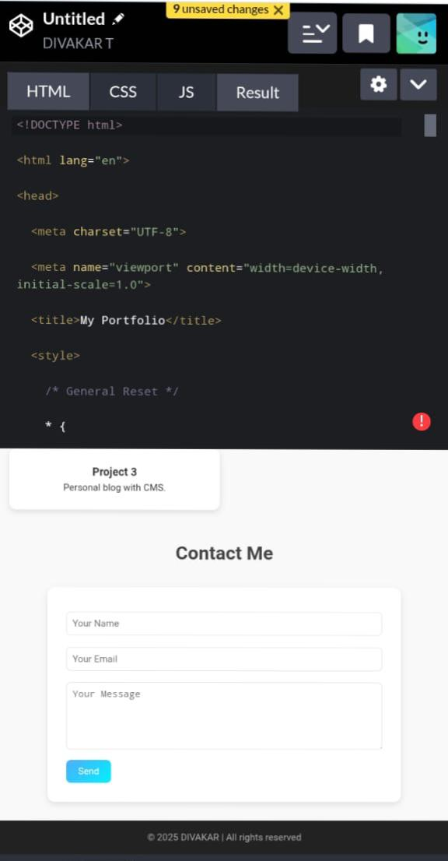

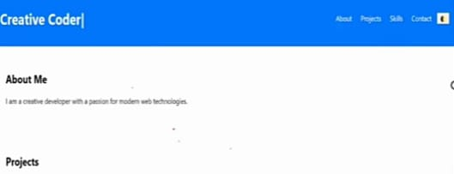
RESULTS AND SCREENSHOTS
Screenshot of each section
Before vs After (plain Html →with CSS & JS)
3/21/2024 Annual Review
10

Slide 11
CONCLUSION
Creating this digital portfolio has been an insightful journey in showcasing my skills and growth as a student in front-end development and software projects. Through designing and developing interactive web pages and applications, I have gained practical experience in HTML, CSS, JavaScript, and project management.This portfolio not only highlights my technical abilities but also demonstrates my creativity, problem-solving skills, and commitment to learning. Each project reflects a step forward in understanding user interface design, responsive layouts, and functional programming.In the future, I aim to further enhance my skills by exploring advanced frameworks and real-world development projects. This portfolio serves as a foundation for my career in web development and a testament to my dedication to continuous improvement and innovation.
11

